Slide 1
HTML5 un CSS3 skolā
Aija Lūse

Slide 2
HTML5 – standarts no 2014.gada
Izstrādā World Wide Web Consortium (W3C) un Web Hypertext Application Technology Working Group (WHATWG).
Apvieno un uzlabo HTML un XHTML 2.0.
HTML5=HTML+ CSS+ DOM+JavaScript
Plašas multimediju iespējas, var iztikt bez Flash
Labāka kļūdu pārvalde
Vairāk hiperteksta, mazāk skripta
Neatkarīgs no ierīces – der arī mobilajām iekārtām

Slide 3
HTML5 – īss piemērs
<!DOCTYPE html>
<html>
<head>
<title>Nosaukums</title>
</head>
<body>
</body>
</html>

Slide 4
HTML5 jaunās iespējas
Tags <canvas> 2D zīmējumiem
Multimediju tagi <video> un <audio>
Jauni tagi lapas strukturēšanai <article>, <footer>, <header>, <nav>, <section>
Jauni formas ievadelementu tipi - calendar, date, time, email, url, search
Iespējas lokāli saglabāt lapu un strādāt bez interneta

Slide 5
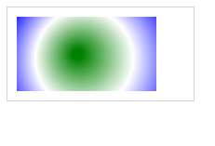
HTML5 <canvas>
<!DOCTYPE html>
<html>
<body>
<canvas id="myCanvas" width="200" height="100" style="border:1px solid #d3d3d3;">
Your browser does not support the HTML5 canvas tag.</canvas>
<script>
  var c=document.getElementById("myCanvas");
  var ctx=c.getContext("2d");
  var grd=ctx.createRadialGradient(75,50,5,90,60,100); // Create gradient
  grd.addColorStop(0,"green");
  grd.addColorStop(0.5,"white");
  grd.addColorStop(1,"blue");
  ctx.fillStyle=grd; // Fill with gradient
  ctx.fillRect(10,10,150,80);
</script>
</body>
</html>

Slide 6

HTM5 <video> un <audio>
<!DOCTYPE html>
<html>
<body>
<video width="320" height="240" controls>
<source src="movie.mp4" type="video/mp4">
<source src="movie.ogg" type="video/ogg">
Your browser does not support the video tag.
</video>
</body>
</html>
<!DOCTYPE html>
<html>
<body>
<audio controls>
<source src="horse.ogg" type="audio/ogg">
<source src="horse.mp3" type="audio/mpeg">
Your browser does not support the audio element.
</audio>
</body>
</html>

Slide 7
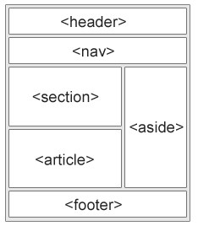
HTML5 lapas dalījuma tagi
Vecais variants:
  <div id="nav">
  <div class="header">
  utml.
HTLM5 – jauni semantiskie elementi <nav>, <header> utml.
Bez CSS3 tik skaisti nebūs!

Slide 8
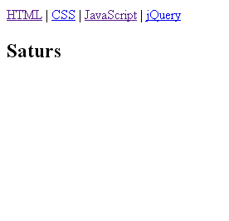
HTML5 lapas dalījuma tagi – bez stila
<!DOCTYPE html>
<html>
<body>
<nav>
  <a href="/html/">HTML</a> |
  <a href="/css/">CSS</a> |
  <a href="/js/">JavaScript</a> |
  <a href="/jquery/">jQuery</a>
</nav>
<section id="saturs">
  <h1>Saturs</h1>
</section>
</body>
</html>

Slide 9
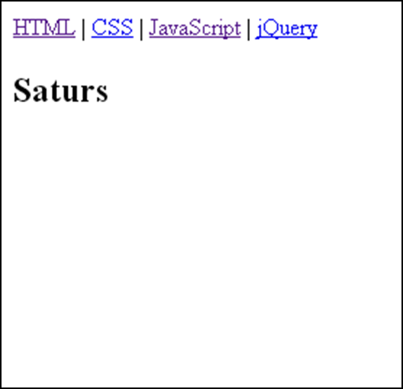
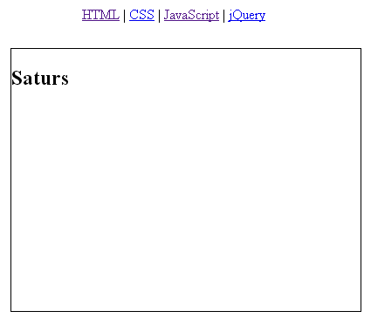
HTML5 lapas dalījums - ar stilu
<html><head>
<style>
nav{ position:fixed; top:10px;left:100px;
width:400px; height:50px;}
section { position:relative;
top:50px;left:10px;
width:400px;height:300px;
border:1px solid;}
</style></head>
<body>
<nav>
  <a href="/html/">HTML</a> |
  <a href="/css/">CSS</a> |
  <a href="/js/">JavaScript</a> |
  <a href="/jquery/">jQuery</a>
</nav>
<section id="saturs">
  <h1>Saturs</h1>
</section>
</body>
</html>

Slide 10
Nav pārnesti no HTML 4.01 uz HTML5
<acronym>
<applet>
<basefont>
<big>
<center>
<dir>
<font>
<frame>
<frameset>
<noframes>
<strike>
<tt>

Slide 11
Piemērs – kā bija font.html
<h1 align="center">
<font color="#008000" size="7"
face="Staccato555 TL Baltic">
<marquee align="middle"
behavior="alternate" bgcolor="#00B02D" height="59" width="93%">Mana lapa.</marquee>
</font>
</h1>

Slide 12
Piemērs ar HTML5 un CSS3 - fontCSS3.html
<!DOCTYPE html>
<html>
<head>
<link rel="stylesheet" type="text/css" href="fontCSS3.css">
</head>
<body>
<div id="fons">
<div id="teksts">Mana lapa</div>
</div>
</body>
</html>
</html>
Notes:
Stils pilnībā atdalīts no HTML

Slide 13
Piemērs ar HTML5 un CSS3 - fontCSS3.html
#fons { width:800px; height:100px; background:#00B02D; }
#teksts { font-family:myFirstFont; font-size:40px;
top:50px; position:relative;
animation:myfirst 5s;
-webkit-animation:myfirst 5s; /* Safari and Chrome */}
@keyframes myfirst { 0% {left:0px; top:50px;} 100% {left:600px; top:50px;}}
@-webkit-keyframes myfirst /* Safari and Chrome */{
0% {left:0px; top:50px;} 100% {left:600px; top:50px;} }
@font-face{ font-family: myFirstFont; src: url(MAGNETOB.woff); }

Slide 14
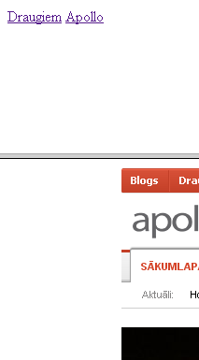
Piemērs ar ietvariem – kā bija
<!DOCTYPE html>
<html>
<frameset rows="25%,75%">
<frame src="menu.html" >
<frame src="http:\\w3schools.com" name="a">
</frameset>
</html>
<a href="http://www.draugiem.lv" target="a">Draugiem</a>
<a href="http://www.apollo.lv" target="a">Apollo</a>

Slide 15
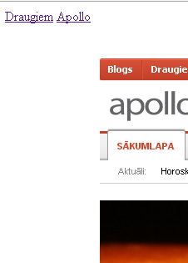
HTML5 un JavaScript
<!DOCTYPE html>
<html><head> <style>
section{width:100%;height:600px;} nav{width:100%;height:5 object{width:100%;height:600px;}; </style>
<script type="text/javascript">
// written by: Coothead
function updateObjectIframe(which){
document.getElementById('one').innerHTML = '<'+'object id="foo" name="foo" type="text/html" data="'+which.href+'"><\/object>';
}
</script> </head>
<body>
<nav>
<a href="http://www.draugiem.lv" onclick="updateObjectIframe(this); return false;">Draugiem</a>
<a href="http://www.apollo.lv" onclick="updateObjectIframe(this); return false;">Apollo</a>
</nav>
<section id="one">
<object id="foo" name="foo" type="text/html" data="http://w3schools.com"></object>
</section>
</body></html>

Slide 16
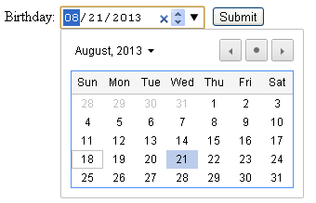
HTML5 formas
<!DOCTYPE html>
<html>
<body>
<form action="demo_form.asp">
Birthday: <input type="date" name="bday">
<input type="submit">
</form>
</body>
</html>

Slide 17
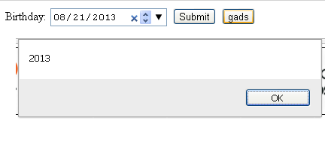
Formas un JavaScript
<!DOCTYPE html>
<html>
<body>
<form action="demo_form.asp">
Birthday:
<input type="date" name="bday">
<input type="submit">
<input type="button" value="gads" onclick=alert((bday.value).substring(0,4))>
</form>
</body>
</html>

Slide 18
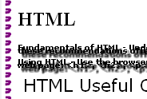
Tas vēl nav viss..
Ģeolokācija
<svg> - vektoru grafika
Drag and drop
Saglabāšanas iespējas
Fona režīms
Jauni stila elementi – rāmji, ēnas u.c.
  body {
  border-image:url(border.png) 90 60 round;
  -moz-border-image:url(border.png) 90 60 round; /* Old Firefox */
  -webkit-border-image:url(border.png) 90 60 round; /* Safari and Chrome */
  -o-border-image:url(border.png) 90 60 round; /* Opera */
  }
  p{
  text-shadow: 0.5em 0.5em 0.2em #000;
  }

Slide 19
Izmantotie materiāli
w3schools.com
www.html5rocks.com

