Slide 1
Projekta apraksts un piedāvājums skolām
Augusts, 2013

Slide 2
Konteksts
Latvijā pēc dažādiem novērtējumiem ir
10000
IT speciālistu uz
2 m iedzīvotāju
Somijā uz 5.4 m iedzīvotāju ir
100000
IT speciālistu
Lielākajās augstskolās
ir minimāls konkurss
un vietas 4 apmācību gados ir
aizpildītas uz pusi
No 350 vidusskolām
programmēšanu
māca maksimāli 30
Vidējais IT industrijas atalgojums ir 3-4 reizes lielāks par Latvijas atalgojumu,
10 gados tas izaug
no 300 līdz 1800
Ar IT saistīto jauno biznesu uzsākšana vidēji prasa mazākus kapitāla ieguldījumus

Slide 3
Secinājumi
Latvijai ir liels neizmantots potenciāls
Palielināt IT eksportu apjomus
Palielināt nodokļu iekasēšanu
Samazināt emigrāciju, nodrošinot ar kvalitatīvām darba vietām
Patlaban lielākais bremzējošais faktors ir speciālistu trūkums
Statistika rāda, ka ir jāpalielina to skolēnu skaits, kuri programmēšanu izvēlās par savu nākotnes profesiju.

Slide 4
Par projektu Start(IT)
Kāpēc šāds projekts ir nepieciešams?
Pieprasījums pēc IT speciālistiem pieaug ne tikai Latvijā, bet arī citviet Eiropā. Lai palielinātu IT speciālistu skaitu Latvijā, jau skolas laikā jāsniedz padziļinātas zināšanas informātikas priekšmetā, jāmaina priekšstati par programmēšanu, veicinot interesi izvēlēties IT nozari studijām un nākotnes profesijai. Šobrīd programmēšanas priekšmets nav pieejams visiem vidusskolu skolēniem, tāpēc ar projektu «Start(IT)» aicināsim skolotājus piedāvāt fakultatīvās nodarbības programmēšanā saviem skolēniem.
Projekta mērķi
Palielināt to skolēnu skaitu, kas informātikas priekšmetu apgūst padziļināti;
Dubultot IT studentu skaitu Latvijas 10 lielākajās augstskolās
3-5 gadu laikā.

Slide 5
Start(IT) programma
Skolēnu un skolotāju iesaistīšana
Bezmaksas elektroniskie kursi
IT skolotāju konference
Fakultatīvo
skolu tīkls
Plaša
koalīcija

Slide 6
Start(IT) programma
Skolēnu un skolotāju iesaistīšana
Nodrošināt programmēšanas zināšanu potenciāla izpratni un atzīšanu skolēnu starpā. Piešķirt tam kūlīgo faktoru. Panākt IT skolotāju iesaistīšanos. Nodrošināt sabiedrības atbalstu, apmācības, palīdzību pāriet uz jauno programmu

Slide 7
Start(IT) programma
Bezmaksas elektroniskie kursi
Izveidot interneta pieejamu programmēšanas skolu. E-Skola nodrošinās attālināto apmācību. Visi kursi būs pieejami latviski un krieviski. Būs nodoti ‘open source’ īpašumā un tiks mainīti balstoties uz open source principiem.

Slide 8
Start(IT) programma
Fakultatīvo
skolu tīkls
Papildus skolotāju iesaistīšanai, balstoties uz skolās pieejamiem datoriem, izveidot fakultatīvas skolas.

Slide 9
Start(IT) programma
IT skolotāju konference
Organizēt regulāro konferenci IT (nākotnē matemātikas skolotājiem). Konference ļaus saliedēt skolotājus, apmainīties ar viedokļiem, sniegt jaunākas ziņas par IT.

Slide 10
Start(IT) programma
Plaša
koalīcija
Izveidot koalīciju no augstākas izglītības iestādēm, pašvaldībām, skolām,
IT uzņēmumiem, citiem uzņēmumiem.

Slide 11

Pašreizējie dalībnieki

Slide 12
Provizoriskais plāns
2013
2014
2015
2016
Kursu veidošana
  Izveidot bāzes kursu
  Izveidot portālu
  Apmācīt pasniedzējus
  Izveidot 2. pakāpes kursu
Fakultatīvas skolas
  10 skolas
Uz šodienu ir 100 pieteikumi
  30 skolas
  60 skolas
  90 skolas
Skolotāju konference
  Sagatavošanos
  ’13 gads
150
Konferencē ir 370 dalībnieki
  ’14 gads
250

Slide 13
Pilota fāzes organizācija
Pilota fāzes loma
  Dod iespēju satura autoriem un projekta komanda pieslīpēt materiālu
  Dod iespēju skolām sākt ātrāk
Uzdevums
  Nodrošināt atpakaļsaiti, lai projekta komandai izveidotos faktoloģiskais viedoklis par programmas kvalitāti
  Veikt izmaiņas saturā un sistēmā
Prasības skolām
  Piedalīties iknedēļas 1 stundas nākamas lekcijas pārskatos, izmantojot Skype. Pirms pārskata lekcijas iepazīties ar materiālu, sagatavot jautājumus
  Pēc novadītas lekcijas aizpildīt anketu par lekciju; anketa ir nepieciešama, lai komanda uzlabot saturu un sistēmu
Prasības organizatoriem
  Laicīgi gatavot nodarbības materiālus un nedēļu pirms lekcijas novadīt pārskata lekciju
  Apkopot anketās saņemto informāciju un informēt dalībniekus par vidējo, anonimizēto viedokli

Slide 14
Plānotas tuvākas aktivitātes
Datums | Aktivitāte
29.Aug-06.Sep | Pirmā pārskata lekcija pilota skolām
01.Oct | Rudens tālizglitības grupa
01.Dec | Otrā semestra saturs

Slide 15
Darba tirgus tendences

Slide 16
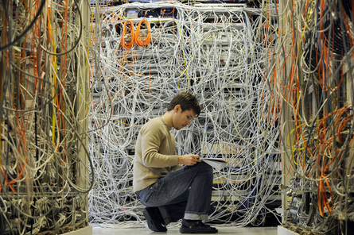
Kur palika visi tīkla administratori?

Slide 17
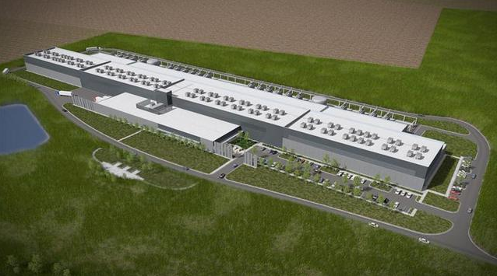
Kur palika tīkla administratori?

Slide 18
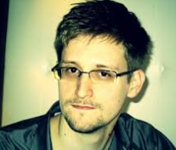
Paldies mr. Snoudenam

Slide 19
Atgriežamies pie fundamentālām zināšanām
Laika periods | Profesija
1997-1999 | Tīkla administrators
1998-2001 | Programmētājs
1999-2003 | Projektētājs
2000-2007 | Projektu vadītājs
2007-2009 | Uzņēmuma vadītājs
matemātika
Psiholoģija
Valodas
Fizika
Socioloģija

Slide 20
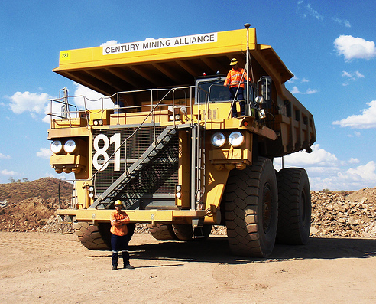
Automātiskās mašīnas ir jau lietošanā
Pieder Rio Tinto, kas ir Anglijas-Austrālijas kalnrūpniecības uzņēmums
Programma tika uzsākta 2008.gadā
Plāns ir pāriet no 10 līdz 150 mašīnām 10 gados
Neviena incidenta pirmajos 3 gados
Viens no pamata iemesliem ir lielas šoferu algu prasības
Kāds būs pamata iemesls pārejai uz automātiskām mašīnām?

Slide 21
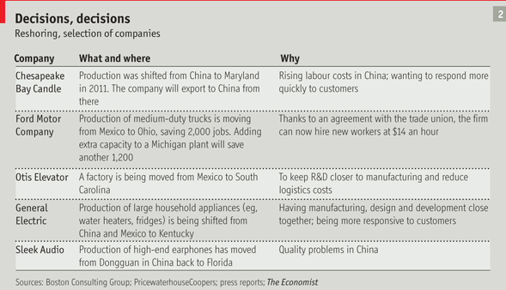


Vai tiešām viss ir tik slikti?

Slide 22
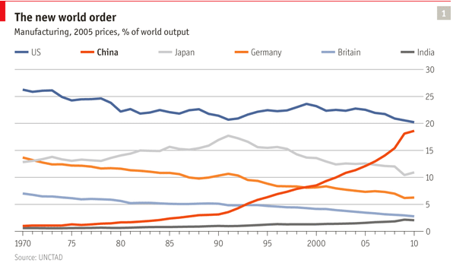
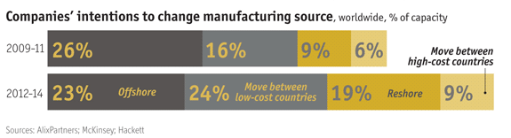
Kas notiks ar ražošanu?

Slide 23
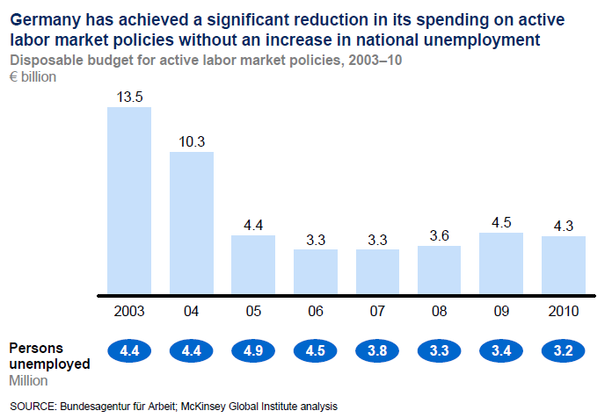
Kāpēc e-biļete vairos darba vietas?
Latvijas valdības budžeta ieņēmumi ir ~7miljardi EUR

Slide 24
Darbinieku pieprasījums
Avots: www.cv.lv (2012.gada augusts - 2013.gada jūlijs)

Slide 25
Accenture Technology Vision 2013
Notes:
For those of you who may not be familiar with our Vision, let me give you a bit of background. Each year, the Technology Vision team at Accenture Technology Labs sets out to determine the emerging IT developments that will have the greatest impact on enterprises, government agencies, and other organizations in the next few years.
Our vision is based on a distillation of our extensive research over the course of the previous 12 months, along with the experiences of our research teams and the input of our own industry experts and clients.
A key input into our Vision is an exploration and analysis of key technology megatrends that are impacting technologies and businesses today and in the next few years.

Slide 26

Every Business Is a Digital Business
Accenture Technology Vision 2013
Notes:
Technology is now intertwined with nearly every aspect of the business – and it is fast becoming a primary driver of market differentiation, business growth, and profitability.
Also, software is absolutely integral to how we currently run our businesses, and to the future. How we redesign and produce things, how we create and manage new commercial transactions, how we begin to collaborate at unprecedented levels internally and with customers and suppliers.
In the new world, our digital efforts will be the key to how we innovate and expand our business. That is why Accenture believes that understanding technology change—the trends that impact your business—is no longer just the realm of IT. This year’s Accenture Technology Vision lays out the major technology trends affecting organizations in the public and private sectors.
It is time for every executive—CIO, CMO, and CEO—to grasp its importance and use technology to pursue success. There is a higher order of thinking—a digital mindset—that will, we believe, separate tomorrow’s most able organizations from their lesser rivals. And this is why we contend in our 2013 Vision that Every Business is a Digital Business.
Tonight I’d like to walk you through our 7 key trends which represent technologies that are available today. We believe that now is the time to act – many of the areas always listed as “hot trends” like mobility, cloud, virtualization are well past the point of exploration and experimentation. It’s time to view them as practical, available tools which can help address some of your toughest problems and help pursue your greatest opportunities.

Slide 27


Mērogojamas
attiecības
Aizvietojam
tranzakcijas
ar saskarsmi
Notes:
Today, consumers are no longer just buyers - they’ve evolved into connected consumers. Not just connected through communications and devices – but digitally connected with each other through interests, opinions, experiences and purchases.
That is why businesses need to hit the reset button and think differently when it comes to customer relationships. What’s required is not a small improvement. It’s an inflection point enabled by emerging technology that will take customer relationships beyond transactions to personalized interactions. Digital relationships and personalization at scale is a key opportunity for companies to establish deeper consumer insights, more compelling user experiences and new customized interactions.
Businesses today have new ways to learn about consumers – all based on richer digital interactions. Whether through e-mail, social media, the Web, online chat, or location-based services, or on the many mobile devices consumers use today, building relationships at scale is about creating meaningful interactions with consumers wherever they are and whenever they need it.
But it’s not just about deeper insights. New technology has brought us to a point where enterprises must shift from a focus on cost and channels, to a focus on using the channels and the data derived from them to build longer term and productive relationships.
While e-commerce provided big opportunities for market and customer growth, mastering digital relationships will be key to growing customer engagement and loyalty.
Examples:
Walgreens CIO accelerated its technology overhaul to digitize its business by introducing a new loyalty rewards program designed to consolidate information from its 6.1 million daily customers across 7,900 stores. They introduced things such as enabling people to pay with their smart phones with a PIN which also allows them to push marketing pitches.
Catalina has used QR codes and shopper profiles to send cross-sell offers in-store based on shopper histories and profiles
SAP and Burberry have enabled retail sales associates to pull up consumer profiles in-store using an iPad which provides contact info, transaction history, recommendations on purchases, and social media comments.

Slide 28
Move beyond e-commerce and marketing
Industrialization replaced craftsmanship with production, never again did we enjoy the same relationship we had with the corner shop with the newly born big service providers and mass producers
The first wave of CRM solutions was focused on making it technically possible and economically viable to keep track of so many clients
Now with Digital Personas of the consumers visible through social networks and algorithms becoming ever stronger in translating likes and visits into wishes and intents
We can create personalized service propositions, customize every experience, now we can move to mass personalization of services;
Earlier it was only the corner shop owner who could propose you your favorite brand of wine, today it can also by Maxima ( our local analogue of Wallmart)
We can start creating digital relationships, instead of multipyling transactions

Slide 29
Consumers aren’t just buyers
These digital relationships will enable consumers to become your advertisers
There are numerous portals where people can hail or brag about you
The good old days of ads and focus groups are going away
The electronic channels we established to save costs, should now be used to form relationships
The new mobile & social platforms are not there to push the message the way we did on the internet through ads
It will be a new relationship, based on service and value
Deeper interaction should lead to better and more insights
People can move quickly and entirely digitally from awareness to recommendation
  This new level of customer intimacy allows to compress the sales cycle
  It can also increase impulse purchases

Slide 30

Projektēt
analītikai
Uzdod sev svarīgāko
Jautājumu
tad noprojektē
sistēmu
Notes:
Organizations are no longer suffering from a lack of data, instead they’re suffering from a lack of the RIGHT data. In a recent survey by Coleman Parks Research, they found that only 25% of CIOs believe they have the data they need.
They are being flooded daily with information from every part of their business: operational data, business partner data, data from processes and sensors in addition to customer data from social media, email and call centers. We now have unstructured data sources and industrialized data services supporting a never ending collection of distributed data.
But repurposing all this data to make strategic decisions – like entering a new market or pricing a new service – involves a fundamental shift in how you view your data. Today’s digital business is driven by applications. While they are designed to support functionality, the next generation will also be designed for analytics and decision-making. As this shift is occurring, the gap will widen between companies who understand data to be an asset and those who truly make it their strategic asset to drive business outcomes.
This means that companies will start with the outcome they desire, understand the data required, and then use newer technology to get the right data – from inside and outside the enterprise. This is a big shift. These companies will treat data less as a warehouse and more as a “data” supply chain. They will manipulate it, add to it, update it, and analyze it in various ways, transforming the data into new products and business insights.
So while existing technology allows organizations to store more data and for less cost; acquire and create “missing links” in data from a growing number of structured and unstructured sources; distribute and analyze data faster - to more people - who can “see” it, understand it, and act on it…do you have the master plan in place that answers why? And ensures that the right data is providing the answers to the questions that will create differentiation and competitive advantage?
The technology is there. It’s time to take the next step. It’s time to start designing for analytics —and making the shift to an ‘insight-driven digital business’. Don’t just give the business data, give it the right data.
Examples:
Ford wanted to improve overall satisfaction and decided to start asking questions like, how their consumers used voice recognition, how they personalized their experience using the font size for the dashboard display, etc. To get answers, Ford embedded technology in the cars that answers these questions and more – the driving environment, the electromagnetic forces affecting the vehicle. Ford collects and aggregates data from 4 million vehicles and counting that use in-car sensing and remote app management software to “create a virtuous cycle of information.”
Coke: Orange juice may seem like a relatively simple endeavor. You have a fruit, you squeeze it and produce it. What you may not realize is that the peak growing season for oranges is only 3 months, but Coke needs to produce premium quality juice all 12 months. They use an algorithm that analyzes up to 1 quintillion decision variables in order to consistently deliver the optimal blend. This includes everything from acidity and sweetness to external factors such as weather and crop yield. This helps them plan so that supplies are on hand as far as 15 months in advance – and all at consistent quality and taste levels.

Slide 31
It is all about right data
If you have enough data, you can discern trends, patterns and opportunities. Today enterprises are flooded with data. We’ve learned to get it, store it and even have to tools to analyze it.
The opportunity, which is currently a problem, is in availability of right data
Applications where designed to provide functionality, not data. Applications capture whatever they have. But IT & Business never asked the question – what do we need to know? Want to know what did we always dreamt to know about our consumers. This is a fundamental shift in mindset.
We have to design our systems to get this data. This will become the first part of Data Supply Chain!
We are not just grabbing the data, we are quantifying reality around us.
For example UPS used its GPS data to understand that left turns prolong the journey. Any driver knows it intuitively, but they saw it from their data. So, they re-wrote the routing algorithms to maximally avoid those left turns and saved 9 million gallons

Slide 32
Creating the supply Chain
There is a newly growing market for data and all enterprises should look at the possibilities and pricing to buy; we should also work with our partners to adopt the same philosophy and also come with the data
Foresight: you have to build in a feedback loop into your process, so that providing data becomes profitable for consumers; aim for creating virtuous cycles;
Finally – relationships at scale and design for analytics – should result in a better ability to build business process around insights. Not around processes and efficiency. The next point makes it even more important.

Slide 33

Datu ātrums
Pieskaņot lēmumu un aktivitāšu ātrumu
Notes:
Our previous trend focused on getting the right data. This trend focuses on matching the speed of data to the speed of decisions.
Today, thanks to unstructured data from social media, mobile devices, sensors and applications, the volume of data and data sources available to business leaders is greater than ever. These are often referred to as data volume and variety.
What we’re seeing now is a surge in emerging technologies that deal with the “3rd v” - data velocity.
The more data we collect, the more we want – but large amounts of data aren’t helpful unless companies can make sense of it .
We’re seeing a surge of new technologies across the ecosystem that are helping accelerate the whole data cycle from insight to action.
Data velocities have now reached the ability to scan tens of billions of records a second, or the ability to query 1-2 terabytes in less than a second.
Technologies such as data appliances, no SQL databases, and in-memory computing already accelerate the whole data lifecycle. Gartner predicts the use of in-memory computing to rise three-fold by 2015.
Allow too much time to pass between collecting data and creating actionable insights, and an organization will most likely lose out to fleet-footed competitors. And mobility and consumerization of IT are influencing expectations for faster access to data.
So as expectations of near-real-time access, and response times become the norm, business leaders will rely heavily on ‘higher data velocities’ to gain that all too important competitive edge – simple as that.
Examples:
Union Pacific is on the cutting edge of what’s possible when you combine real time sensor information with predictive software. They’re using this combination to predict conditions that lead to derailments days or even weeks before they’re likely to occur. Prior to this, Union Pacific was only aware of a derailment that was imminent. This left them with only one option – stop the train. Their window of opportunity was seeing into the future.
Vendors:
SAP: The main product here is obviously HANA which is expanding in relevance as SAP enables HANA to accelerate more and more modules. SAP, like all analytics vendors, also has visualization capabilities as well.
Oracle: Exadata is Oracle’s acceleration appliance relevant to the space. They also have visualization tools for users.
Teradata: Teradata would argue that their entire product suite is about data velocity, but the one product that is specifically designed for acceleration is the Extreme Performance Appliance.

Slide 34
The sliding window of opportunity
When the data revolution came about, it was characterized with three Vs – variety, volume, velocity
When we learned to measure the world in just about a real time, we understood that our previous understanding was an approximation
Today, once we are able to measure – we should take advantage of it, otherwise the competition will
This is why we are saying that data should produce actionable insights, we should match the velocity of the data towards our ability to respond as companies
Take electricity company as an example, if they see a surge of electric car registrations which is an external data point, they should expect a higher demand for electricity, which also means the need to invest in the last mile
The precisions of what we know about the state of things was defined by how often we run a batch job to understand say the status of our warehouse

Slide 35
Analyses and recognition
We are getting better than ever in teaching machines to derive actionable insights from data. We are also getting better at presenting the data to the best known pattern recognition machine – the person. Pie-charts and Bar-graphs are the ancient and basic compared to new approaches from Tableu Software and the likes.
An interesting development is data analyses technologies that operate on streams rather than pots of data
When the world is continuously unstable, it is not longer volatile. Rather we now understand that it was never stable, we just the impression it is.

Slide 36

Plastiskā
sadarbība
Sadarbība ir daļa
no biznesa procesa
Notes:
Advances in technology make it easier than ever for people to work together - no matter where you are. But unfortunately today, enterprise collaboration is still stuck in siloed communication channels - from email to video conferencing to social media. And for the most part, people are expected to figure out how to use each of these tools to do their job on their own.
But employees don’t necessarily need to become more social for collaboration to work. It’s the work and the process that need to be social – and when that happens, it will transform the nature of work.
Think about it. Web-based social technologies like Facebook and Twitter have profoundly changed the way people communicate with one another outside of the office.
But in the workplace, most companies are using communications channels that are growing more outdated and isolated with every passing day. And collaboration has generally disappeared from IT systems and processes. Clearly, that needs to change.
In today’s fast-paced digital age, every worker is an information worker: our workforce is expected to be thoroughly informed while simultaneously producing faster results with better information to make better decisions. It’s a tall order! For the enterprise, we believe the new face of collaboration will involve embedding social-driven, collaborative tools into business processes. Organizations will be more productive, more efficient, and more innovative as a result.
We don’t need to wait for the technology: tools such as Yammer, Chatter, JAM and OpenSocial already offer ways for enterprises to easily integrate collaboration into their processes.
These are social networking technologies for the enterprise and they are working right now. Ultimately, more collaborative employees create more productive organizations. Now is the time to put collaboration back into work.
Examples:
Kimberly Clark has taken the next step in collaboration with their implementation of Salesforce.com Chatter. Kimberly Clarke recognized that although there was collaboration already going on through SharePoint what they really wanted was to have “conversations” between people working together not simply exchanging documents and emails. Kimberly realized that different constituencies (sales, marketing, IT) have different needs and uses for these tools so it needs to be embedded within their processes differently. The key to the success that Kimberly Clark is having with Chatter is knowing that the platform has to be easy to use and something people want to use. This includes providing them with the ability to access it from anywhere and on any device.
NBC Universal’s Salesforce.com collaboration tool unifies advertiser activity with sales and includes Chatter function – resulting in better cross-sell visibility and improved advertiser relationships
Boeing’s 787 GEnX – is socially connected to service teams, who have the ability to subscribe streaming data from any plane in the fleet. I think now the question for them now is – can they get the battery to talk to the rest of the engine parts – e.g. it’s really hot in here has anyone noticed?

Slide 37
Social networking breathed live into collaboration
Enterprises are always pushing to improve collaboration in their companies
At the same time, e-mail, a very transactional way to communicate is still a fading but main vehicle; another way to communicate is through an ERP solution which is very structured, but hardly engaging
Enterprises were very successful in getting the new channels used with external customers
But the real change in the enterprise world is still ahead of us. If you don’t want to wait than technologies like Oracle Social Relationship Management tool or Yammer provide for a great experimentation tool.
Collaboration has become the process. An anecdotal example a vice president for IT who sees on chatter that one of the sales people tries to approach a prospect at a company where the VP knows the CIO.
We need to tie colloboration to specific activities to make this job easier.

Slide 38

Programatūras definētie tīkli
Vēl plastiskāki
Notes:
Controlling the flow of information in today’s digital business, where applications, systems, networks and communications channels are constantly changing, is arguably one of the hardest aspects of enterprise IT. And while the virtualization of servers, storage and other parts of infrastructure has resulted in unprecedented levels of flexibility, virtualization has not reached the network until now.
‘Software-defined networking’ or SDN, where the network is managed through software instead of through hardware, is a giant leap forward in enterprise flexibility. It’s clear, the momentum and buzz around SDN is growing because it addresses a big need - making it easier for businesses to manage change, integrate cloud services and get more return from their network investments. SDN is expected to grow from a million dollar, to a billion dollar market, within a few years.
Until now, the network has remained an untapped opportunity because there’s been no easy way to make it dynamic. SDN allows companies to remove the complexity and reduce the cost of network reconfiguration, and turn the network into a truly dynamic and flexible asset. And with SDN businesses will finally be able to complete the last mile of virtualization.
Examples:
eBay is running Nicira’s Network Virtualization Platform in a production OpenStack environment to rapidly test and deploy new Web applications. This allows them rapid network reconfiguration without requiring changes to application or infrastructure components. So that means eBay canj move research and development projects from development and test into production in minutes.
Vendor/Alliance examples:
Cisco: Cisco acquired Cariden and launched Insiemi to bolster its existing, though proprietary, SDN capabilities. They are walking a delicate line between open and closed with SDN capabilities. They emphasize network programmability at a higher level of abstraction than some other players which plays to the strengths of their existing products.
Brocade Communications, Juniper Networks, Hewlett-Packard, Dell, etc.: All of the existing networking players are getting in the game, too. Most are more closely aligned with open standards than Cisco in an attempt to steal market share from them. Juniper Networks announced in Dec 2012 it’s acquiring SDN startup Contrail Systems.
VMware: By acquiring Nicira, VMware enters the networking space as a new entrant. Nicira’s technology fits into with VMware’s overall virtualization strategy and literally creates a virtual network with virtual switches and routers.

Slide 39

Active Defense
Adapting
cyber defenses to the threat
Notes:
Security risks are inherently business risks – and the effects of a breach can be far reaching. There is the operational risk when business is disrupted. The reputation risk when customer information is compromised. And, the financial risk when breaches impact the bottom line.
And while safeguarding business still remains a challenge, we’re seeing major advances in security technology that are compelling new approaches to the old guard. As businesses become more digital, what we’re seeing is an attack surface that’s constantly expanding across more devices, more systems, more people and a broader infrastructure. And, because of all these points of entry, companies need to recognize that an optimal IT security goes further than prevention, it’s about knowing that attackers will get through – and staying one step ahead of them.
With the average organizational cost per data breach over $5million, active defense technologies are emerging to help companies know their enemy, and prevent them from knowing you. Sophisticated data and analytics-driven information security are shifting the security emphasis from monitoring to understanding to taking preemptive action.
Moving target defense systems are an example of another emerging approach that’s gaining attention. Essentially, moving target defense is a non-stop version of musical chairs that turns computer systems into a moving target making it harder for hackers to find and exploit vulnerabilities. Security architectures need to remain flexible and incorporate “active” defenses to deal with the constantly changing field of security threats.
So our guidance is to stay flexible. Stay adaptable. And stay a step ahead with an Active Defense.
Examples:
Think of the New York Times and Wall Street Journal who were recently attacked by Chinese hackers. Just think if they only had Mykonos and honeypotted, what a difference this would have made.
Technologies
Data platform technologies : Splunk, Hadoop, NetWitness
Authentication –DARPA’s “cognitive footprinting” – gathers data and analyzes user behavior to help authenticate access and users
Nok Nok Labs – also provides services for authentication based on usage patterns
Fingerprinting – Mykonos, Crowdstrike
Honeypotting (Cyber smokescreens) – Allure Security Technology, Datasoft
Sandboxing (virtualization) – Invincea, Bromium
MTD (non-stop musical chairs) - Jumpsoft

Slide 40
Active Defense
Security challenge has gone beyond WikiLeaks to a true war between a hand full of countries, namely the US, Israel, China, Iran, Russia;
We see both government institutions engaged in cyber war fare, like in the case of attack on Iran most probably from the US/Israel side, as well as more business like wars which seem to take place between China and the US.
This leaves any business with any serious data at risk, if some of these tools are in the hands of top professional hackers today, tomorrow they will be in the hands of the usual hacker, decreasing the cost of the attack
Today our security thinking is around protecting the perimeter; with the treats above, it is should become active risk-based approaches, analytics driven event detection

Slide 41

Pāri mākoņiem
Mākoņu skaitļošana jau ir realitāte
Notes:
No technology vision would be complete without commenting on cloud computing. While there is a great deal of hype around the term “Cloud”, there is no doubt that technologies underpinning cloud are becoming pervasive and are here to stay.
But, the crucial question the Accenture Technology Vision is asking this year is not “why” should we use cloud? , or “what” hot new technologies have emerged, but rather “how“ should we use cloud?
Cloud will play a role in every Digital Business. While cloud is still in its early days, there is much more that organizations can do to use cloud to enable their business. Whether it’s infrastructure, platforms, or applications in the cloud, as organizations embed cloud into the fabric of their IT, the result is a mix of on-premise and off-premise technology – legacy systems and traditional software mixed with cloud-based technology – and a mix of public and private cloud. This hybrid scenario will be reality for most enterprises as adoption of cloud continues to grow.
Yet, many organizations still consider cloud to be “tomorrows” technology, and have not prepared for the rapid growth of hybrid cloud in a proactive, structured way. The hybrid world of cloud and traditional IT will require a number of changes in the enterprise of today.
First are skills. A hybrid world demands hybrid skills and a technology architect who understands how different components can work seamlessly together.
Second is governance. The IT organization now needs to govern an array of capabilities inside and outside the cloud, so that the business can turn them into new opportunities.
Third, traditional approaches to enterprise architecture will need to change. As-a-Service models change the way technology is consumed, integrated, orchestrated, and secured, and bring with it new ways technology can add value to the business.
Put simply, it’s time to focus on the “how” and put cloud to work in your enterprise. And as we all do this, we expect that in the next few years, the term “cloud” will fade to the background, and we’ll instead focus on underlying solutions that deliver value for the enterprise.
Example
Deutsche Telekom – 6 weeks for a complete travel site

Slide 42



Accenture Technology Vision 2013
Every Business Is a Digital Business
Relationships at Scale
Design for Analytics
Data Velocity
Seamless Collaboration
Software-Defined Networking
Active Defense
Beyond the Cloud
Notes:
So just to recap, there are seven key trends. (read slide)

Slide 43
Accenture Technology Vision 2013
accenture.com/technologyvision
Notes:
Today’s business leaders must use the volatility and uncertainty of global business to frame their challenges. The technology trends we’ve outlined will become the approaches that help transform those challenges into reality.
The reach that technology has in each organization today is unprecedented, and thus its ability to measurably improve business performance is also largely untapped.
There is a growing gulf between the technologies that are increasingly available to address business’s challenges and opportunities and the capabilities of many organizations to utilize those technologies. The faster technology develops, the more that gulf widens.
The time to act is now, the opportunity is at hand. The question is, how many of you will take advantage of it?

