Slide 1
NĪLS MAKLĪNS projekts „Computing at School”

Slide 2
Introducing Computer Science In Schools Across England
Developing a Network of excellence
Niel McLean

Slide 3
Before we start.....

Slide 4
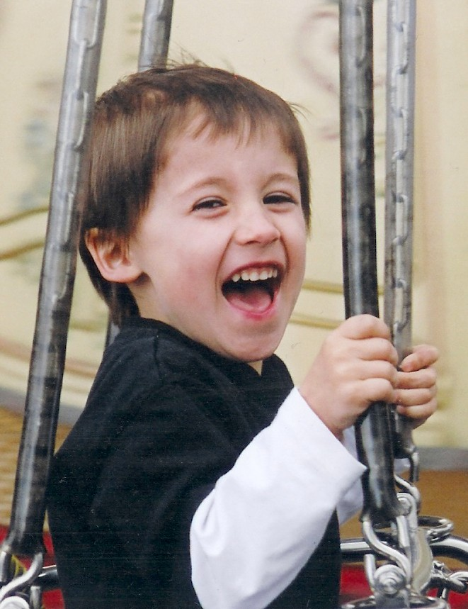
Educational challenges
Continuous change
Scale
High Expectations
New roles
New relationships
New paths
Changing nature of childhood

Slide 5
What’s so special about digital technology?

Slide 6
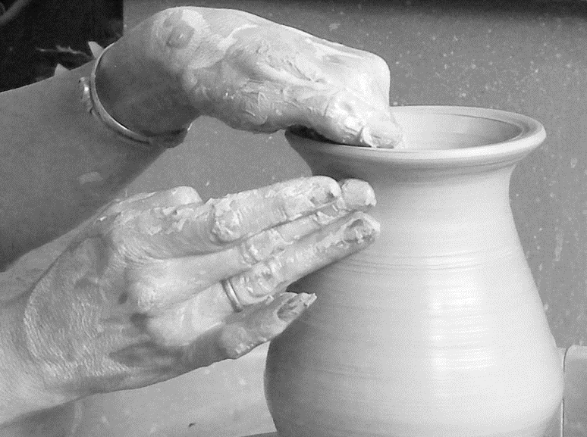
Breaks the traditional link between craft and product.

Slide 7

Extends our ‘reach’.

Slide 8
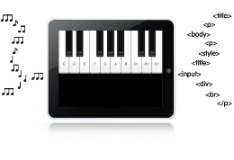
Draws together two human qualities – language and technology.

Slide 9
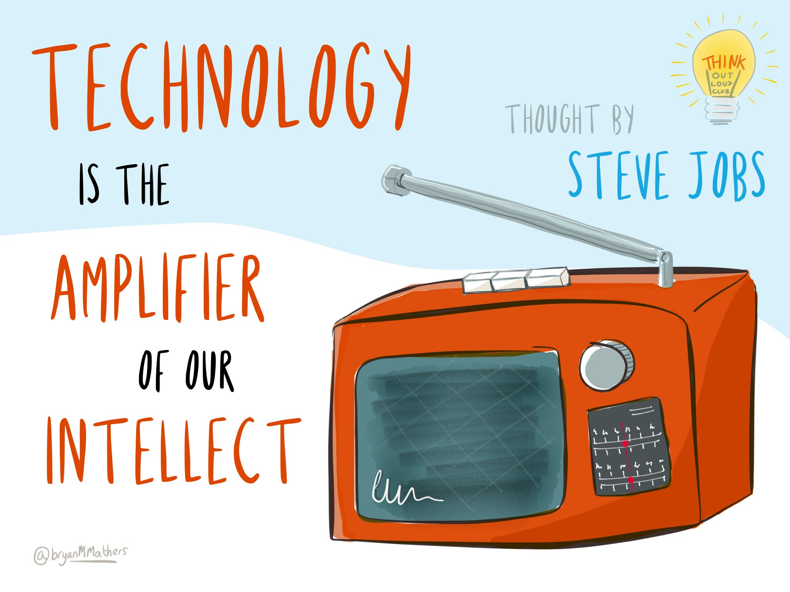

Slide 10

Technology is key to economic growth, productivity and global competitiveness.

Slide 11
8%
  The IT & Telecoms industries contribute a gross value added (GVA) of £75 billion per annum to the UK economy.
  An IT & Telecoms worker is nearly twice as productive as the average UK worker, in terms of GVA per head.
  If businesses exploited ICT fully, they could create an extra £47 billion GVA over the next 5 to 7 years.
x2
£47bn

Slide 12
The IT & Telecoms sector will underpin the majority of future job creation.

Slide 13
  1.5 million (one in 20) UK IT workers are employed in 144,000 workplaces.
  Employment of IT professionals is forecast to grow at almost twice the UK average through to 2020.
  129,000 new recruits are required each year into the IT & Telecoms professional workforce.
1/20
x2
125000+

Slide 14
  And in the wider economy:
  745, 000 additional workers with digital skills will be needed over the period 2013-2017.
  20% (23840) of those jobs will be ideally suited to digitally savy 16-25 year olds
3/4m
20%

Slide 15
Technology is key to the Europe’s economic growth, productivity and global competitiveness.

Slide 16
Sport?

Slide 17
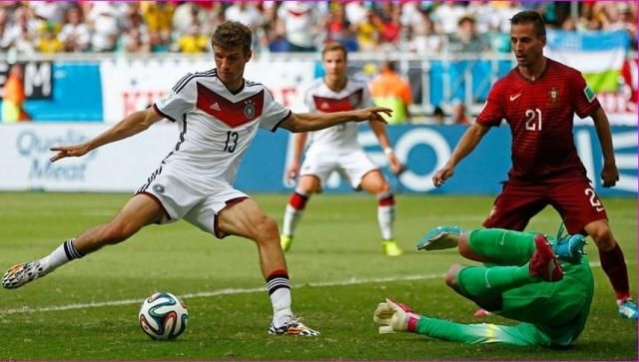

Slide 18
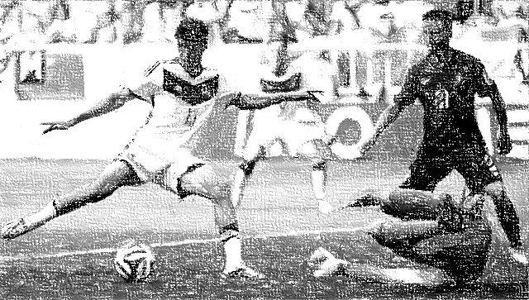
Germany wins the World Cup

Slide 19
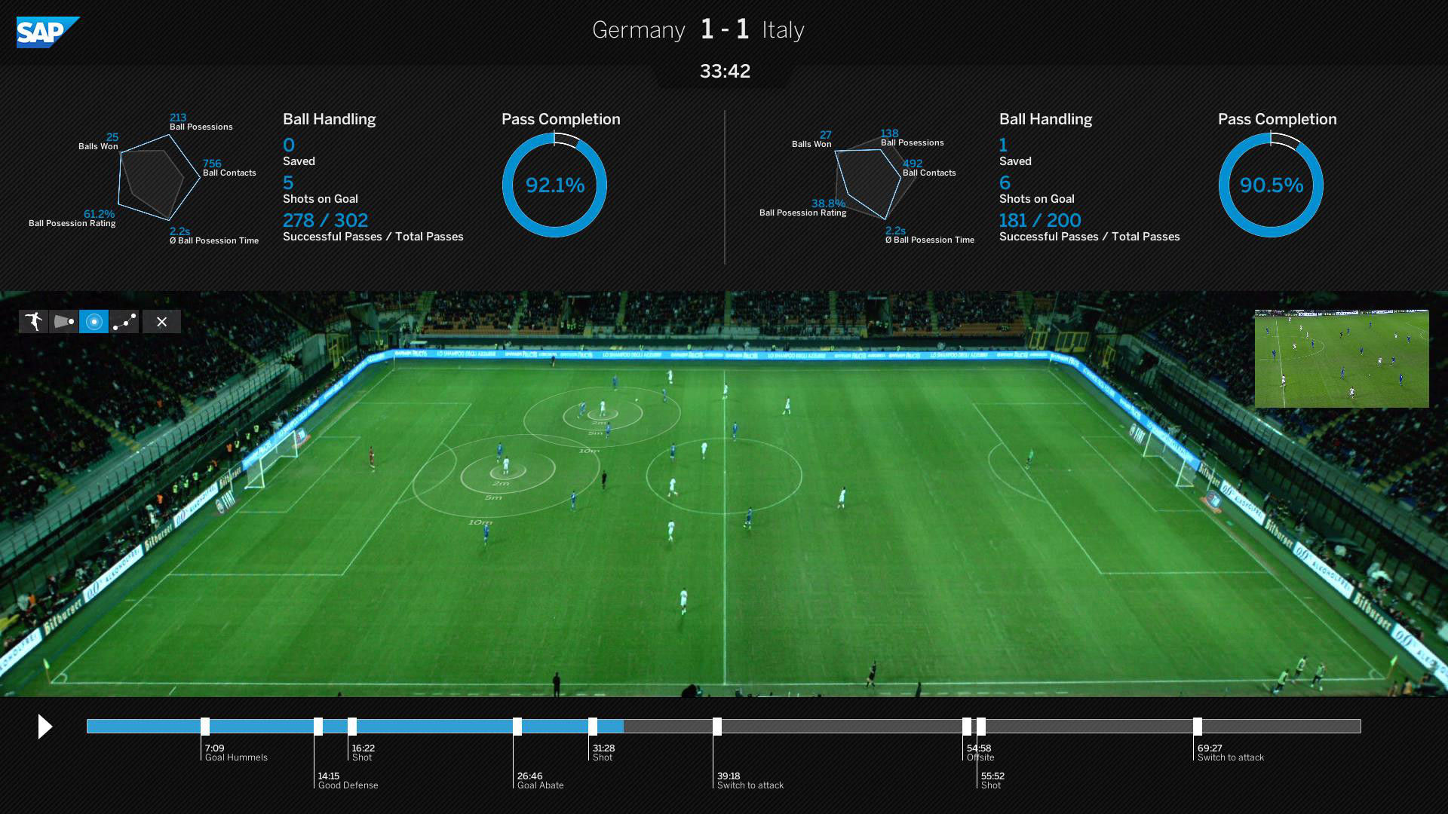
Big Data

Slide 20


Slide 21

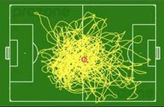
7 000 000 data points in a 10 minute training session.

Slide 22
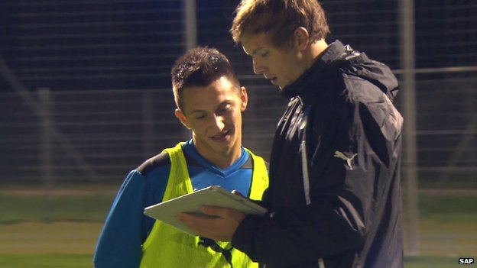

Slide 23

Processed in real time to help players improve.

Slide 24
Fashion?

Slide 25


Slide 26
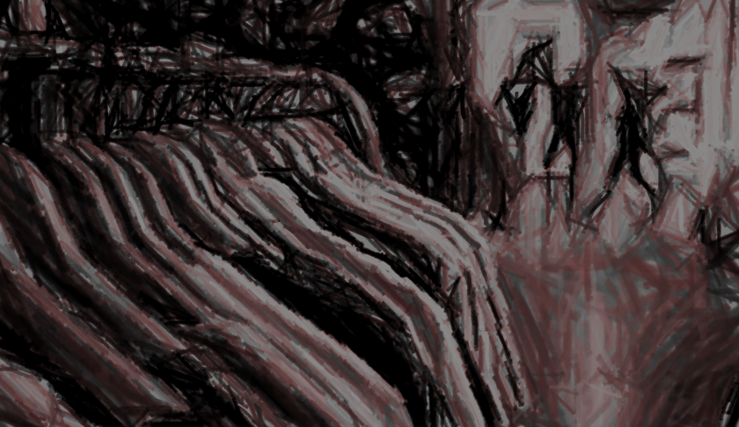
Shape promotion strategies for upcoming seasons.

Slide 27

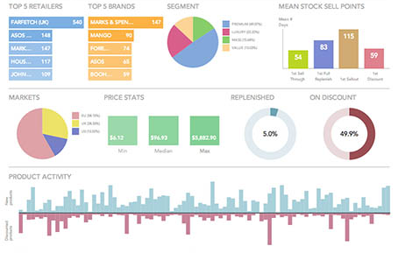
Big Data

Slide 28


Slide 29

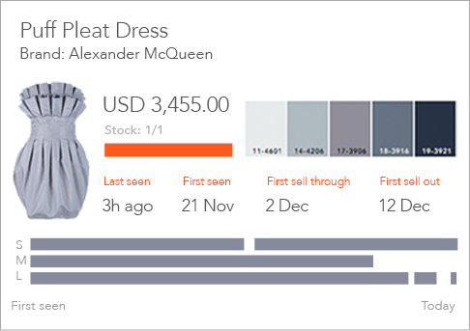
53 billion data points on the fashion industry.

Slide 30
…and it matters to young people …

Slide 31
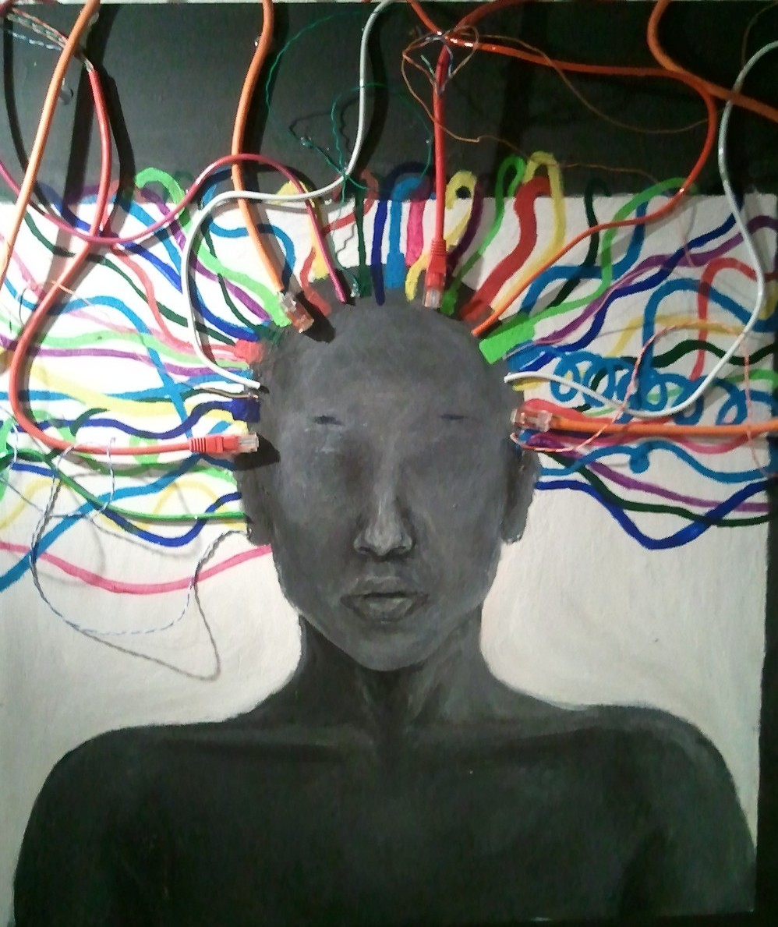

Slide 32
Every child has the right to be taught knowledge and intellectual skills that will help them:
  make sense of the world they live in
  make the biggest possible contribution they can to society.

Slide 33

Our children are growing up in a digital society so we need to teach them
the ideas, principles and concepts that explain how digital technology works
how to become creators and inventors of new digital technologies (hardware and software)
algorithms
logic
imagination
programming

Slide 34
Our Starting Point
CAS was formed in 2008
Concerned about the inadequate teaching of Computer Science (Informatics) in school.
Serious concern that many students were being “turned off” Computing

Slide 35
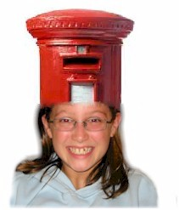
What we had……
Learner as ‘consumer’ - where educational content is ‘delivered’ to the learner.

Slide 36

What we wanted …..
Learner as ‘producer’ - where the learner is provided with the tools to create.
Computing is not simply a ‘conduit for content’ but a powerful tool for thinking.

Slide 37
What is CAS?
It is a grass roots organisation, whose energy, creativity, and leadership comes from its members.
It is now part of BCS, The Chartered Institute for IT
It has formal support from major industry partners, including Microsoft Research, Google, Ensoft.
Its membership is open to everyone, (teachers, parents, exam boards, industry, professional societies, and universities).
It is now recognised as an influential organisation in terms of policy and decision-making at a statutory level.
It is the UK national subject association for teaching Computing.

Slide 38
First success: the new Computing curriculum, starting from age 5
What students should know:
  programing languages, algorithms, data structures, computer architecture, communication and coordination of computer systems
What students should be able to do:
  computational thinking: abstraction, modelling, design, problem solving, programming

Slide 39
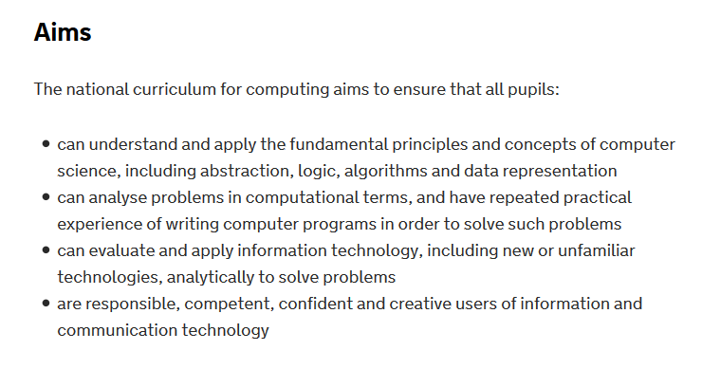
New national curriculum for Computing
For children 5 – 16 yrs old
Focus on computational thinking

Slide 40
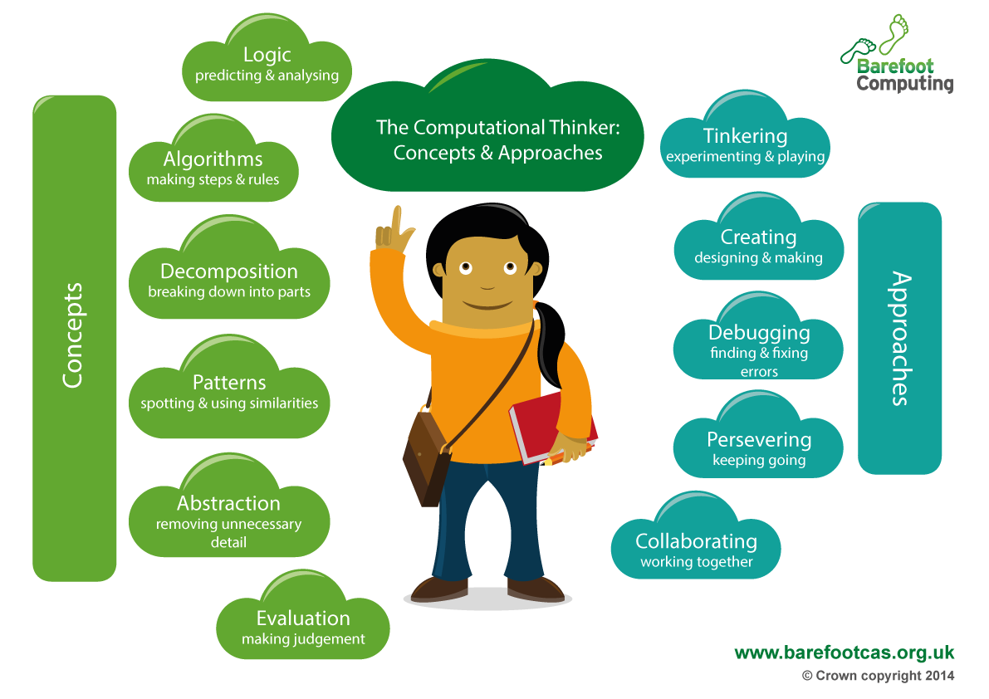

The new curriculum for children aged 5 to 11

Slide 41
But…
It’s no good writing a curriculum that schools can’t deliver!
Challenge, how to equip, support, encourage teachers to teach computing.

Slide 42
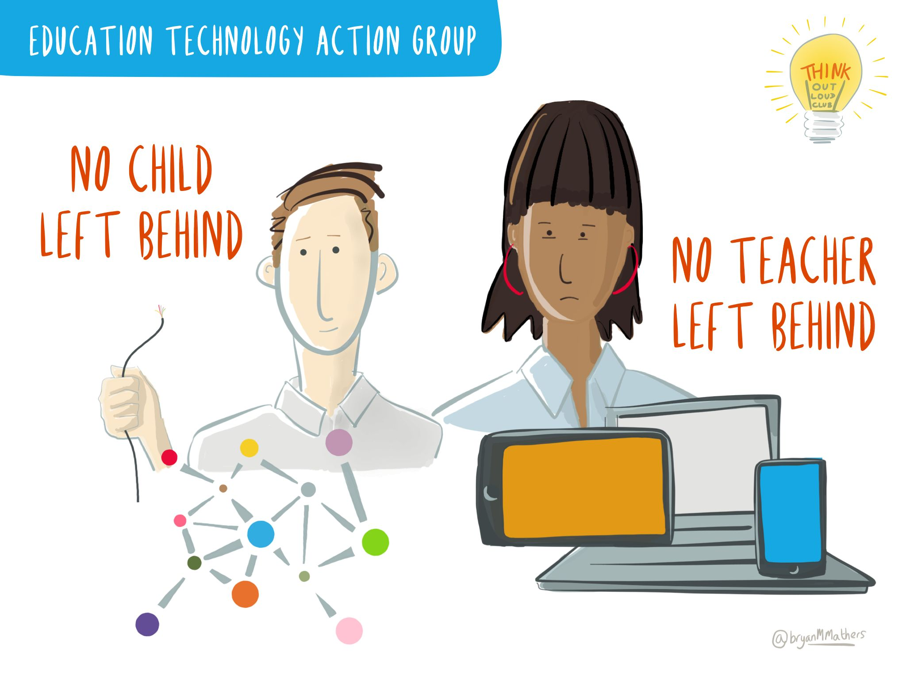

Slide 43


Network of Excellence
New model:
DfE sets policy framework,
we do the work
Old model:
DfE rolls out national training programme

Slide 44




  Collaboration between universities and schools
  Has provided CPD for over 48,000 teachers since 2013
  Includes over 1400 schools as ‘institutional’ members
  Supported by 89 universities, including Cambridge, Imperial, Manchester, UCL, Edinburgh, Oxford, … etc.
  Currently has 380 teachers recruited to the ‘Master Teacher’ training programme
Run by
Funded by

Slide 45
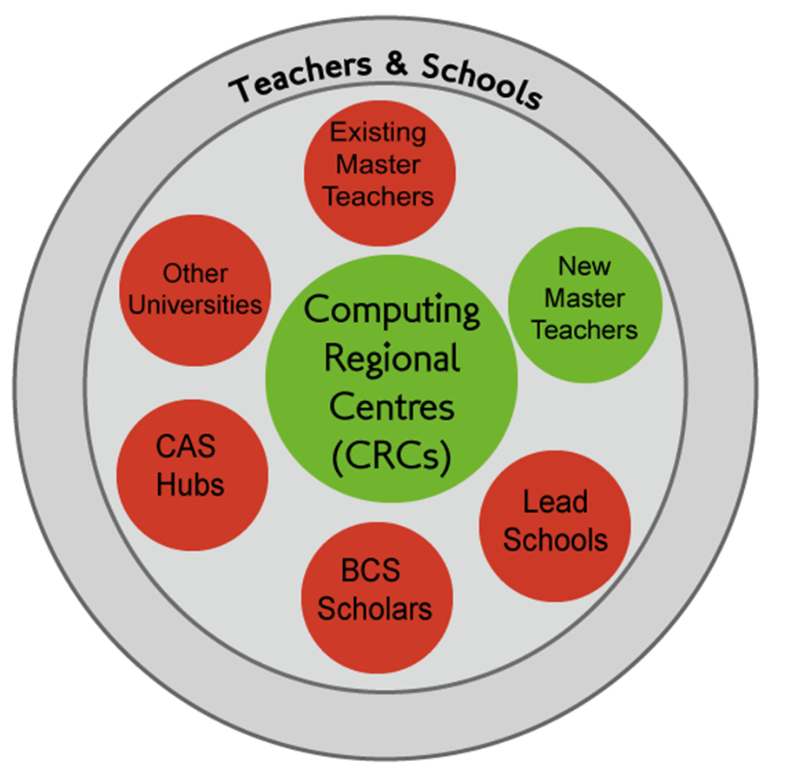

Slide 46
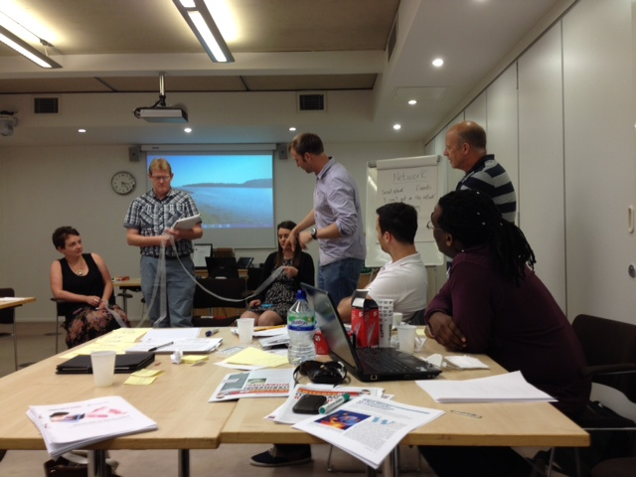
Master teachers
Offer low-cost, local, face-to-face training.
Are peers but have relevant expertise to share.
Act as role models.
Offer individual mentoring/support in school.

Slide 47
Evaluation of master teacher sessions

Slide 48
Impact of training (early days)

Slide 49

Help primary school teachers ready themselves for the new computing curriculum.
Country wide series of 900 workshops run by volunteer experts.
Develop cross-curricular computing resources; available to primary teachers for free
Shows how to improve learning in English, maths and science at the same time as teaching computer science
http://barefootcas.org.uk/
Funded by

Slide 50


QuickStart Computing
CPD toolkit
40,000 packs going into schools in January
Help teachers figure out how to design, develop and deliver imaginative and creative computing in the classroom
Also available for free online http://quickstartcomputing.org/

Slide 51
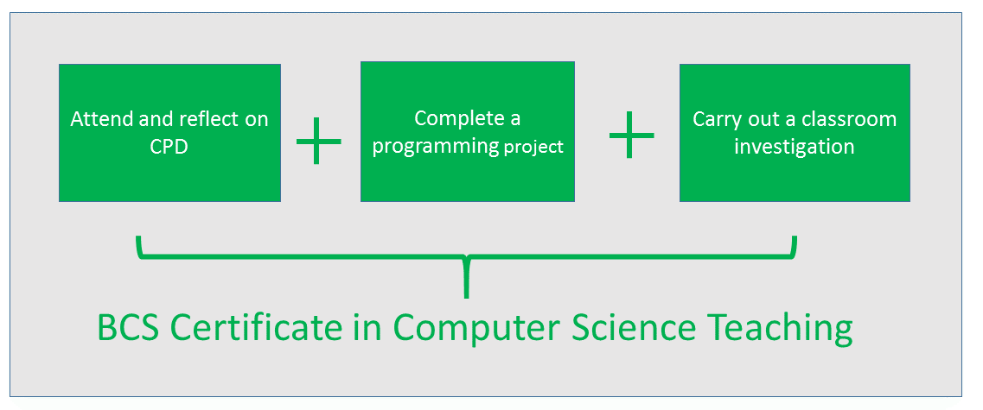
New accreditation programme

Slide 52
Computer Science Teacher Training Scholarships
Purpose: enable the recruitment of outstanding trainee teachers who have the potential to become future leaders of computer science teaching at the national level
Successful scholars receive
  £25k tax free from DfE to attend Initial Teacher Training (ITT) course
  Support and guidance from the CAS during training
  Help with placement in a Lead School.
In 2013/14 BCS awarded 120 teaching scholarships, of a combined value of £3m.
Funded by

Slide 53













BCS Scholarships for Trainee Computing Teachers

Slide 54
Reflections
What have we learned?
  One simple message
  Explain what computer science is
  Start with primary
  Diversity
  There is no "them"; there is only us

Slide 55
What we have learnt
Vision and messages
Young people’s intellectual development and life chances.
Young people as ‘digital makers’.
Communicate with school leaders, industry, parents and young people.

Slide 56
What we have learnt
Curriculum and standards
The curriculum develops young people’s computational thinking – coding is a means not an ends.
Young people learn best in authentic contexts.
Need to map progression in learning.

Slide 57
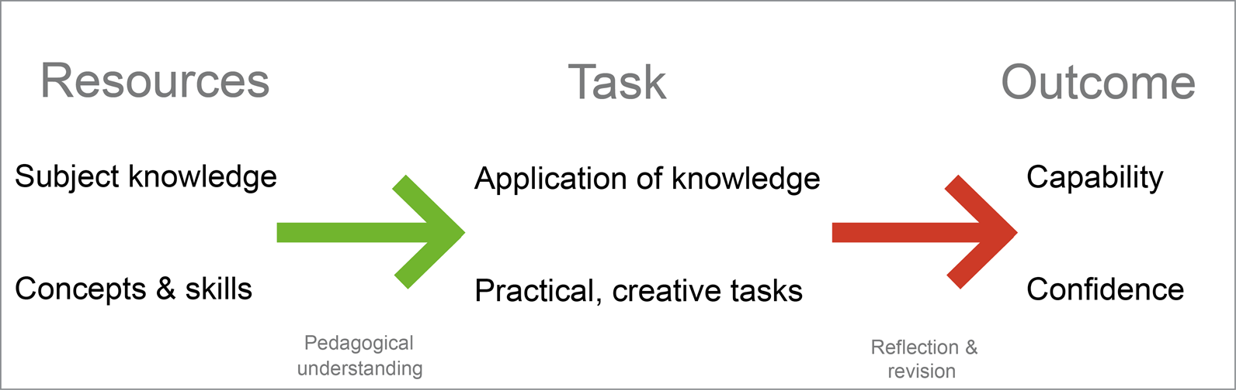
What we have learnt
Curriculum design

Slide 58
What we have learnt
Teacher CPD
Teachers need pedagogical support as well as technical training.
Sustainable support comes by connecting teachers with teachers locally and nationally.

Slide 59
What we have learnt
Teaching resources
Resources need to model effective teaching.
Need to engage with the educational publishers that schools already know.

Slide 60
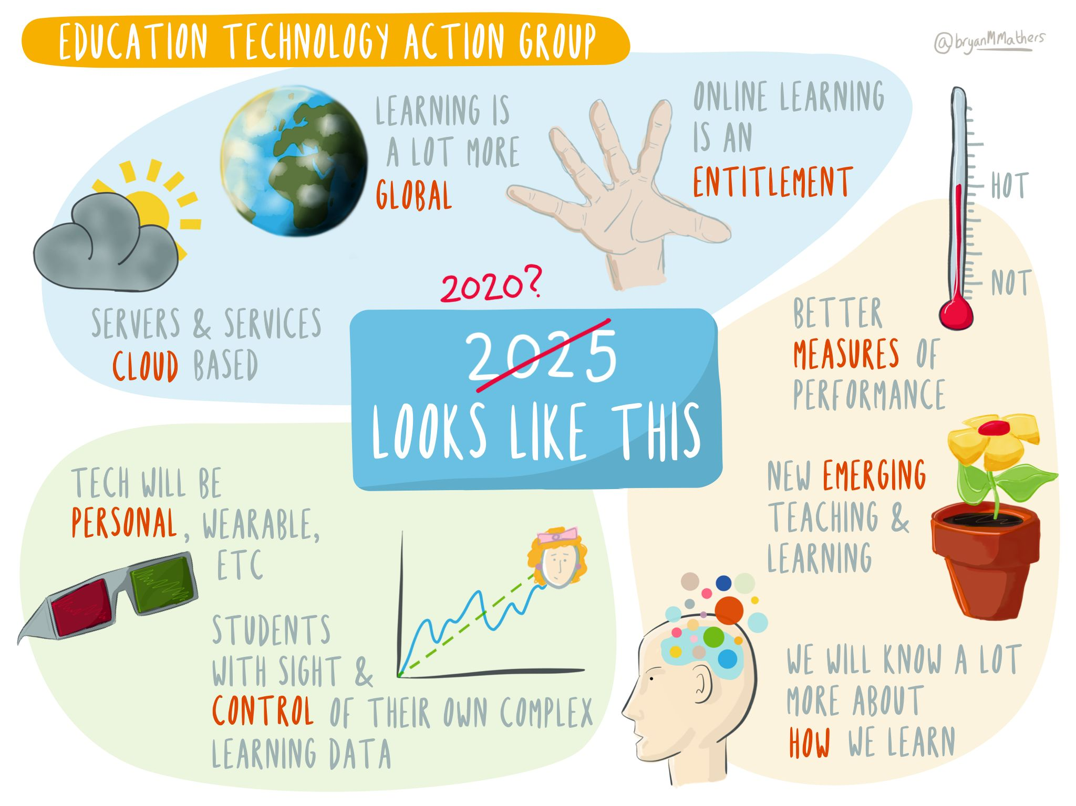

Slide 61
Thank you!
niel.mclean0@gmail.com

